Slide 1
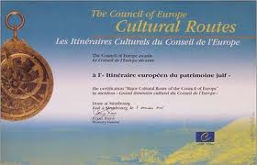
Conceptual Questions of
Thematic Route Development
Dr Melanie Smith, Budapest Business School, Hungary
Email: Melanie.Smith@kvifk.bgf.hu

Slide 2
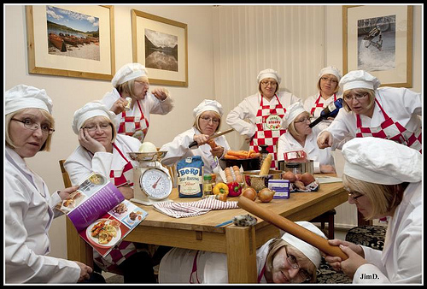
The Challenges of Collaborations
‘Birds of a feather
flock together’
‘Too many cooks
spoil the broth’

Slide 3
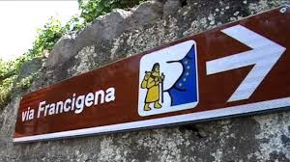
What is a Themed Route?
„tourism products that associate a selected theme with natural and created attractions that can be reached by a variety of means of transport.....Taking the principle of sustainability into account, these routes offer opportunities to gather information, have fun, and relax simultaneously.”
(Puczkó & Rátz, 2007:132)
„a cultural, educational heritage and tourism co-operation project aiming at the development and promotion of an itinerary or a series of itineraries based on a historic route, a cultural concept, figure or phenomenon with a transnational importance and significance for the understanding and respect of common European values.”
(Council of Europe, 2010)
The Cultural Routes programme of the Council of Europe comprises 29 certified Routes that cover 70 countries
France (10.4%) heads the list followed by Italy (9.7%), Spain (8.4%), Portugal (5.8%), Germany (5.2%) and Great Britain (5.2%). The rest of the countries each comprise 2.6% or smaller percentages.

Slide 4
Examples of Themed Routes
Religious and spiritual routes (e.g. Santiago, Via Francigena, Jewish Heritage, Cluniac Sites)
Civilisations (e.g. Vikings, Normans, Hanseatic League)
Gastronomic routes (e.g. wine, cheese whisky, plums)
Heritage routes (e.g. Castle Road, European Route of Industrial Heritage , Central European Iron Trail)
Classical Music (e.g. Mozart, Chopin)
Pop Music, Film (e.g. Rock ‚n’ Stroll, Dublin, Film locations, UK)
Handicrafts (e.g. Silk Route, Textile Route)
Nature (e.g. Parks and Gardens; The Routes of the Olive Tree)

Slide 5
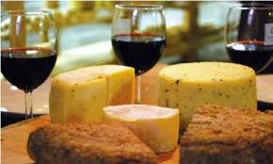
Who Uses Themed Routes?
Pilgrims
Wine and cheese lovers
Fans of literature,
art and music
Those interested in history and heritage
Health tourists

Slide 6
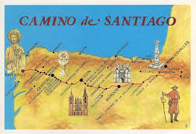
Concepts: The Easy Part?
„Developing a cultural route seems to be an easy job: One just needs to select a theme, assign a few attractions to it, and deliver it to all potential consumers using promotional tools. Nevertheless, there are several stumbling blocks to implementing such a project”
(Puczkó & Rátz, 2007:132)
Cost
Co-ordination
Implementation
Marketing
Sustainability
Quality

Slide 7
The Concept and the Reality
The promotion of a common European identity and citizenship
Fostering awareness of and increasing education about heritage
Encouraging widespread community participation in cultural activities
Creating cross-cultural networks and partnerships
Developing new tourist attractions
Creating opportunities for small businesses
Image enhancement of relatively unknown destinations and sites
Opportunities for joint marketing
Linking countries or destinations with very large distances between them
Maintaining a route with little or no funding
Trying to organise regular meetings for all partners
Different levels of commitment
Overcoming language barriers
Most tourists will not have heard of the route
Posting enough signs to direct the tourists across long distances
Printing enough materials including online information
Maintaining sustainability and quality

Slide 8
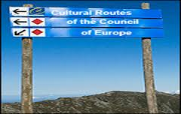
Improving European Cultural Routes
According to an extensive Council of Europe study in 2010 the most urgent issues that Cultural Routes need to address include the development of better:
transnational connectivity of the Cultural Routes network;
co-ordination at European level of the development and promotional strategies of the Cultural Routes;
brand image and marketing strategies;
quality and sustainable tourism standards development/implementation;
human and financial resources of the Routes;
expertise in the management of the networks;
exchange of good practices; and
network management and performance evaluation tools.
„the types of tourism activities being created by most of the Routes seem to have little overlap with some of the other main themes of the Council of Europe, such as human rights, democracy, social cohesion and intercultural dialogue”. (2010:34)

Slide 9
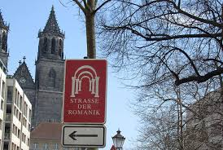
Case Studies of Good Practice
Case studies of the Cultural Routes show that there is collaboration emerging between the Cultural Routes and tourism SMEs to develop cultural tourism (Council of Europe, 2010). Examples include:
the development of interactive guides (Transromanica)
links to new audiences via social media (Transromanica, Hansa Youth);
new celebrations (for example, Hansa International Festival);
new heritage merchandise (all Routes);
joint marketing with hotels and restaurants (all Routes);
joint promotion with transport providers (Hansa);
gastronomic tourism (Olive Tree);
agritourism/ecotourism (Via Francigena, al-Andalus).

Slide 10
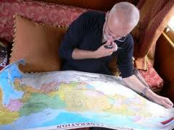
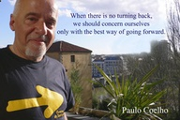
Conclusions
„Several initiatives developed within the Cultural Routes have a rather esoteric character. They fail to reach out to broader interest groups, and are rather locally oriented”. (CoE, 2010)
„It is important to note that the Cultural Routes are not business organisations, which are usually considered as innovation hubs. The Cultural Routes are rather a means to preserve and showcase European cultural identities. Thus, while the Cultural Routes can provide a good climate for innovation and sustainable development for tourism SMEs and cultural tourism support actors, they should not be subject to overcommercialisation. (CoE, 2010)
Funding will usually determine life-span and activities
Difficult to take a symbolic concept to a practical level
Implementation is always harder than conceptualisation!

Slide 11
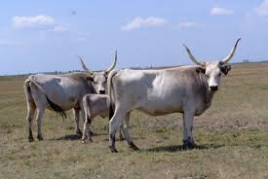
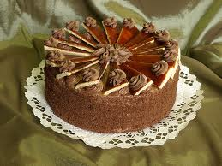
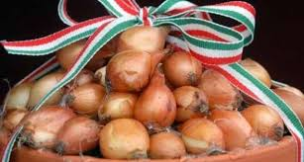
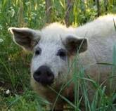
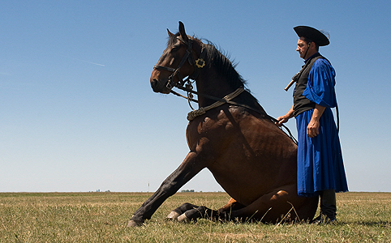
The Hungaricum Route?

